Slide 1
Team 5 – programming languages
Michael Young – 18050174
Josh Williams – 18034055
Josh Medhurst – 17131049
Ben Phillips - 18034012

Slide 2
Introduction
There are many languages that users can choose to learn and programme with. Programming is essentially a set of instructions that are executed to produce a certain output.
There are 2 types of levels in programming, this includes High Level and Low Level. Higher level languages are easier to read, write and maintain. An example of this would be Python. Lower level languages are harder to utilize as they require deeper knowledge of the machine language and is closely related to machine code.

Slide 3
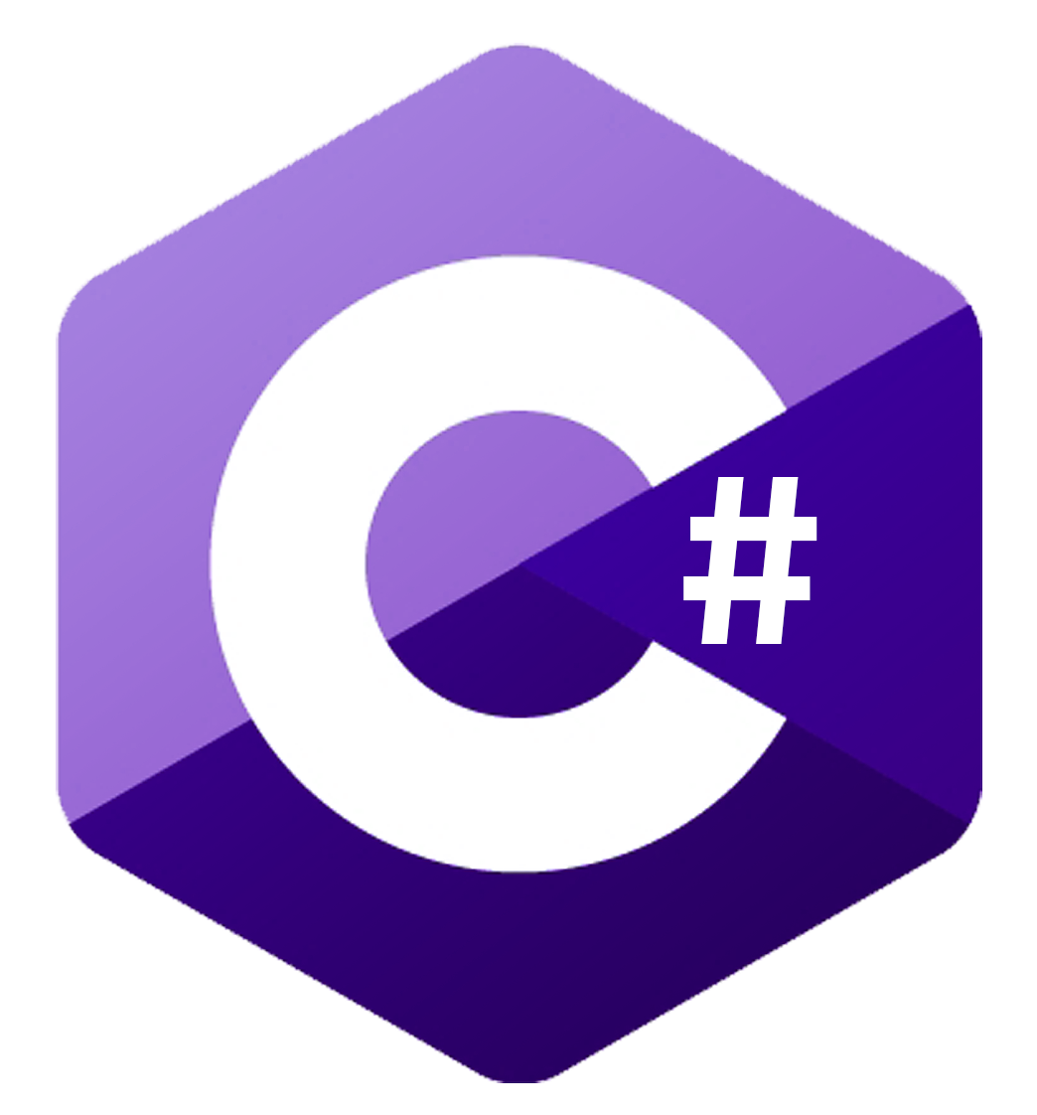
C# and its advantages
C# is the preferred programming language that is used in backend programming for things such as building infrastructures in an IDE.
C# has many advantages, this often includes:
Easy integration with Windows meaning that you don’t need any special configurations to run a C# program.
Fast and open source, a large variety of tools are available on GitHub which are available for beginner programmers to use.
Cross Platform ability to be used between different operating systems such as Windows, iOS and Android.

Slide 4
Disadvantages of c#
However along with the advantages to C# there are disadvantages. These often include:
C# is an internal part of the .NET framework so the server running the application must be windows based
C# runs slowly, and the program needs to be compiled each time when any changes are made

Slide 5
Python and its advantages

Slide 6
Disadvantages of python

Slide 7
C++ and its advantages

Slide 8
Disadvantages of c++

Slide 9
Java and its advantages

Slide 10
Disadvantages of java

